Slide 1

Diffusion of Patient Safety and Performance Improvement across Cambridge Health Alliance: Starting the Journey
Gouri Gupte PhD, MHA
Director of Performance Improvement
ggupte@challiance.org
Paul Allen,
Chief Quality Officer
pdallen@challiance.org
Karen Schoonmaker, MSN, RN
Director of Risk Management and Patient Safety
kaschoonmaker@challiance.org

Slide 2

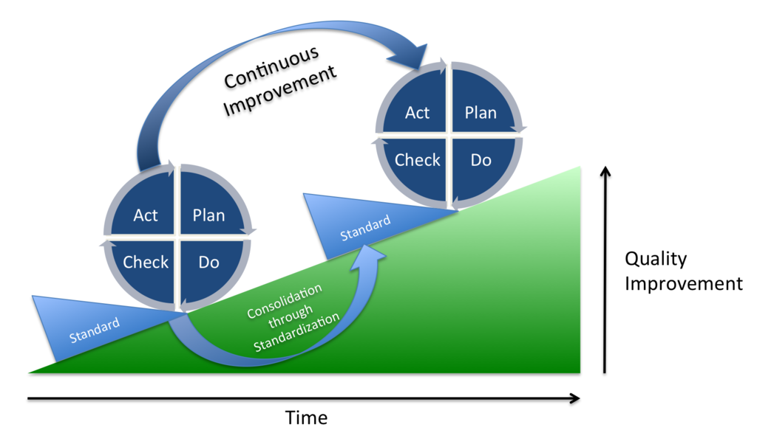
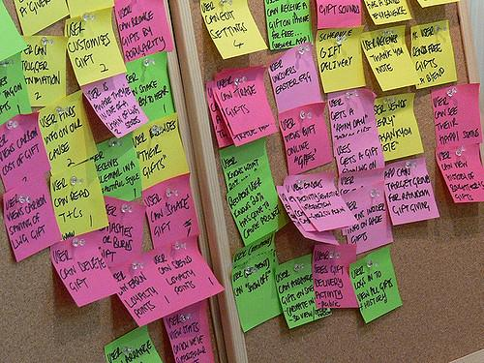
AGENDA
PI at CHA
Our successes
Lessons learned
Next steps

Slide 3
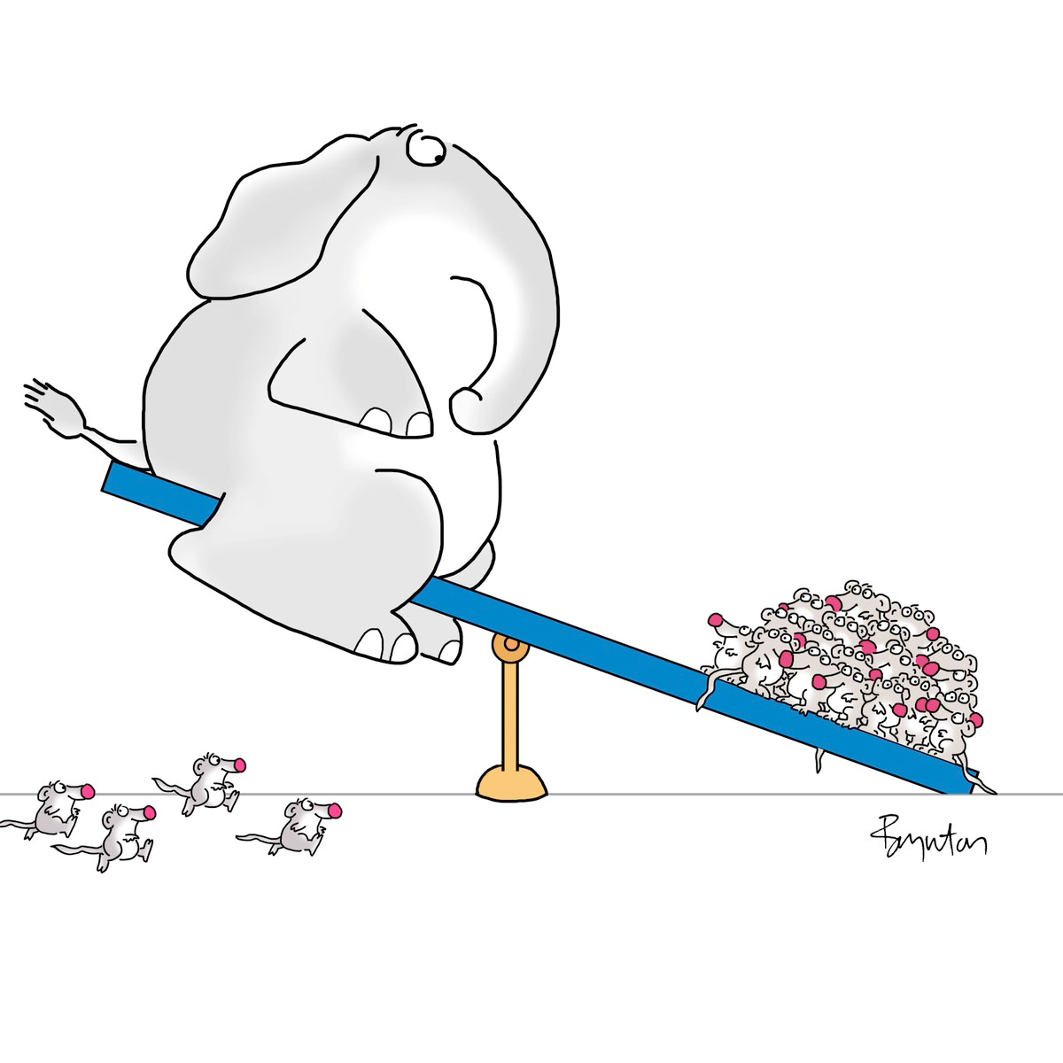
Difficult things can be accomplished given enough enthusiasm, joy and purpose

Slide 4
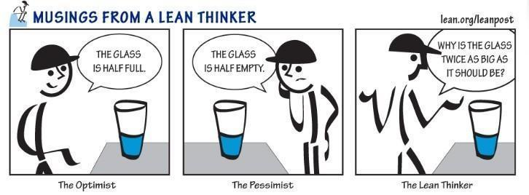

Slide 5

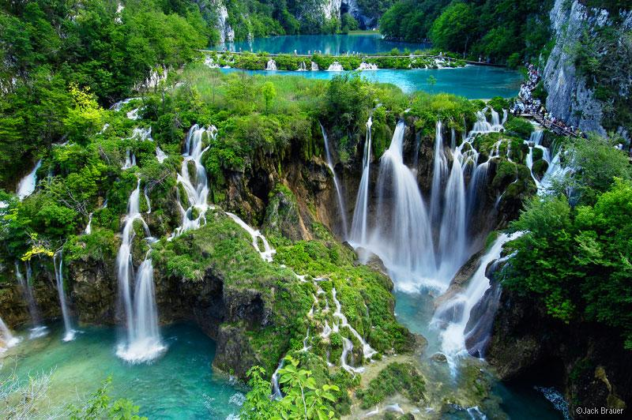

Slide 6

ACCESS

Slide 7
ACCESS our Performance Improvement Value Stream
"The ease with which CHA patients and communities are able to use appropriate services to meet their health needs and exceed their expectations for quality and service."
To accomplish these goals the "True North Metrics" have been identified as:
Develop efficient systems that enable the patients to easily:
    Get to us
    Communicate with us
    Get in to see us

Slide 8
Diffusion of PI across CHA
Leadership Commitment and Engagement
Pilot testing- training
CHA vision and goal for performance improvement
Staff and patient engagement
Developing training
Working with leadership
Lean training
Data analytics
Lean Infrastructure
Identifying existing work
Learning about CHA

Slide 9

Our early steps……Projects-Training-Pilot
Focused
  Project management and performance improvement tools
Appropriate buy-in
  Invested and engaged
  Right people
Data driven
  Pain points
  Aligned with growth metrics
Structured

Slide 10
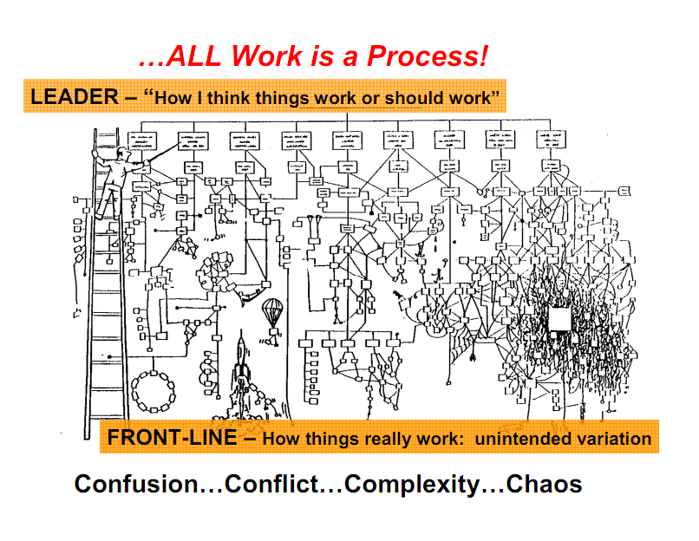

Slide 11
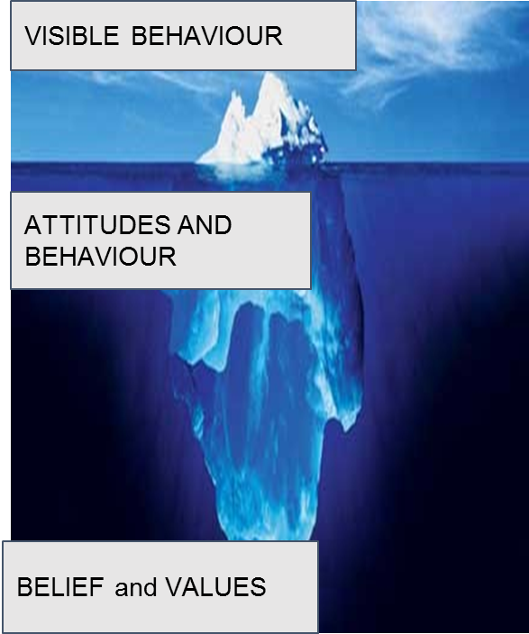

Slide 12

AND THE JOURNEY STARTED…………………..

Slide 13
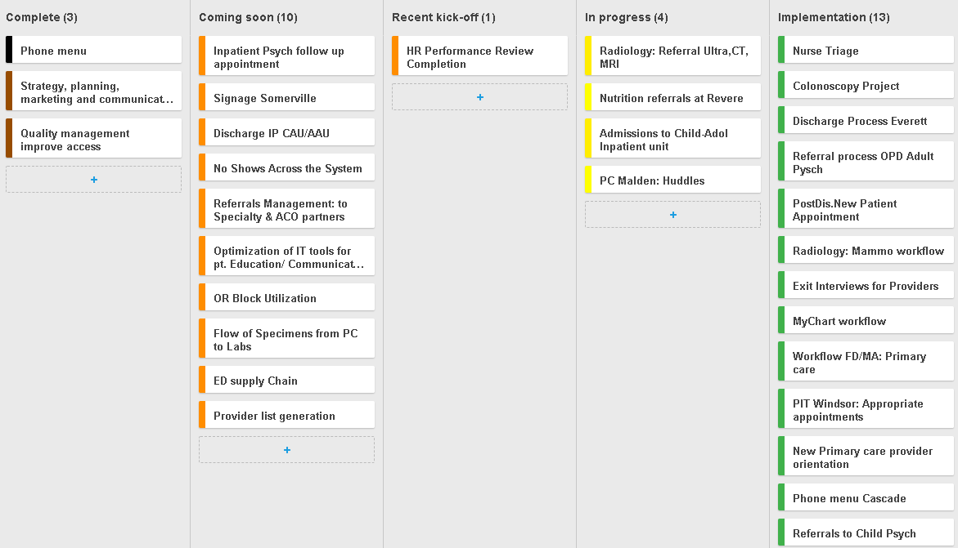
CURRENT EFFORTS: February, 2018

Slide 14
Specific projects and measurement
Granular level
Metrics and measurement
MACRO
MESO
Value stream and “True North metrics”
MICRO
Excellent patient experience & PI
A great place to work
High-value, sustainable operations
Additional strategic measures

Slide 15
System wide process
System wide process
Interactive process
Interactive process
Local Process
Local Process
Local process
Local Process

Slide 16
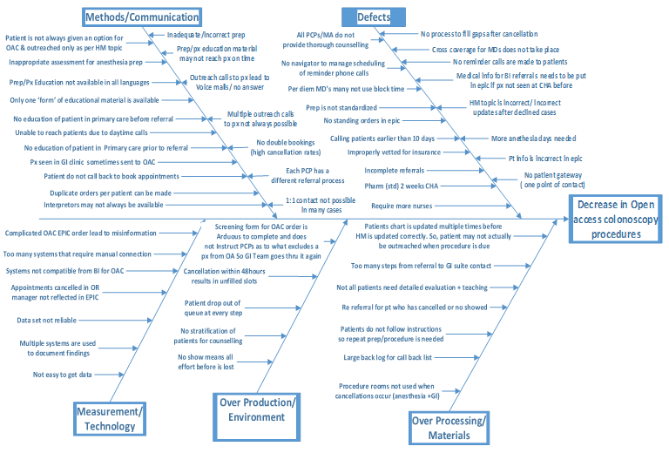
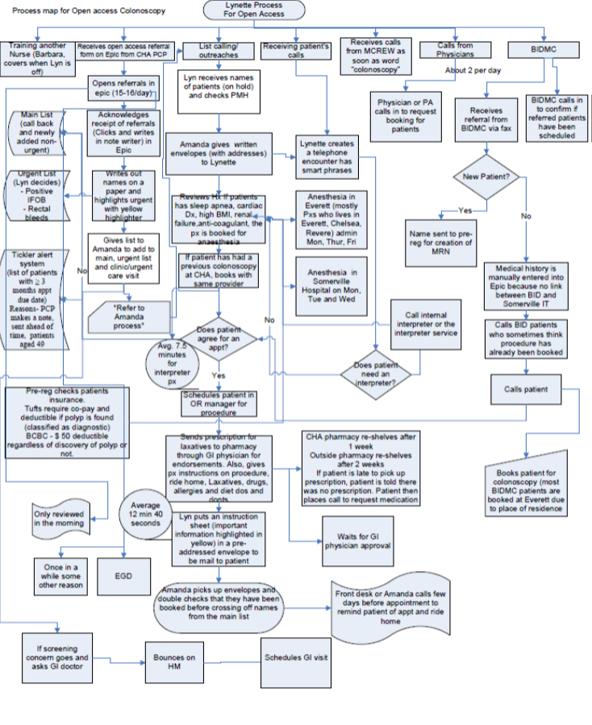
Gemba walks, process maps, fishbones, rapid improvement events, & impact-effort matrices

Slide 17
Patient Journey from ……... to …….. at CHA
Data: …...2017
1 MONTH
1 WEEK
# Referrals sent to Specialty
# Distinct Patients referred
# Patients outreached
# Patients scheduled
# Patients seen/ monthly
# Patients seen weekly
Outmigration and patients lost to follow up
Cancellations and no shows
XX% in clinic 1
XX% in clinic 2
Duplicated referrals
Outmigration and patients lost to follow up
Primary Care
Specialty Department

Slide 18



CAPACITY ANALYSIS: SPECIALTY DEPARTMENT___________* WEEKLY
2/4/18. ** Exclusions
Current Utilization of Clinical FTE = visits/ available hours
Unit A: ### hrs billed
= #%
New Patients Seen
Unit A: ####
(... Scheduled)
Clinical FTEs
*without changing CART/ backouts
Unit: ##...
NP per FTE
UNIT: ####
CURRENT UTILIZATION
Follow-ups Seen
Unit A: ####
(...Scheduled)
Infrastructure to support providers
Scheduler & Registration: #
Nurse/MA/ Caseworker: #
Space: ## rooms at x clinic: # exam rooms, # offices, group rooms,etc.
Follow-ups per FTE
UNIT: ####
Potential Current Utilization of Clinical FTE
Unit: #% = ….. hrs seen
#%= ….hrs sched.
New Patients Seen
Unit A: #### (..... scheduled)
Clinical FTEs
*without changing CART/ backouts
UNIT: ####
NP per FTE
UNIT: ####(.... scheduled)
NEAR ACCURATE ACTUAL CAPACITY
Follow-ups Seen
Unit A: #### (..... scheduled)
Follow-ups per provider
UNIT: #### (.....scheduled)
New Patients Seen
Unit: ____
New Patients Seen
Unit:____
Future State Utilization of Clinical FTE
Unit: __%, ___% NS
Clinical FTEs
*cleaning CART/ backouts
Unit: ____
FUTURE STATE
Follow-ups
Unit:____
Follow-ups
Unit: ____

Slide 19
Performance improvement success
Shared vision: “We get it. We understand the importance to CHA. We need to work this problem to achieve success”
Engaged Leadership: “We own this and will drive change and will advocate for what we need to get it done”
Workforce engagement: “We understand this issue and/or process well and can contribute in ways that will make what is developed better and more efficient.”
Supported by collaborative expertise: “We will help you work the problem bringing appropriate tools and guidance to bear and the additional support to keep us all moving toward improvement.”

Slide 20
What’s next!!!

Slide 21
Example PI thinking applied to “non-project”
Working the solution vs. working the problem
The solution: This MACHINE/POLICY/DOCUMENTATION will improve our patient care and improve quality metrics.
Buy the machines
The problem: How do we get consistent MACHINE/POLICY/DOCUMENTATION measurements for patients who need them in our clinics so as to improve care and get “credit” for doing a good job ?
Identify the patients
Develop workflows (before, during or after provider; orders vs. standing orders; who does testing?)
Assure documentation standardization (can it be automatic?)
Buy the machines that best match workflow and documentation needs
Train the staff
Develop Billing codes and procedures to capture on claims data (no claim = no “credit”)
Supply chain for new testing equipment
Etc. etc .
Measurement to confirm positive influence on metric

Slide 22
Prioritizing Where to Focus
Hospital Opportunities
Medical Office Opportunities
Teamwork
Staffing
Communication
Work pressure and pace
Source: Advisory Board Survey Solutions.

Slide 23
Quality Improvement (Metrics,Waivers and Outcomes)
Vestibulum congue
Performance Improvement
Risk and Patient Safety
Vestibulum congue
Vestibulum congue
Accreditation/ Regulation
Department of Quality and Patient Safety

Slide 24
Diffusion of Patient Safety and Performance Improvement across Cambridge Health Alliance: Starting the Journey
Gouri Gupte PhD, MHA
Director of Performance Improvement
ggupte@challiance.org
Paul Allen,
Chief Quality Officer
pdallen@challiance.org
Karen Schoonmaker, MSN, RN
Director of Risk Management and Patient Safety
kaschoonmaker@challiance.org

